Slide 1
DDS Analytics Talent Management EDA
Presented by Cleveland Johnson

Slide 2
Agenda
We will use the data to answer the following questions:
What does our data look like?
What data was removed?
What factors lead to attrition? What are the top 3?
Can we build a model to predict attrition?
What factors contribute to monthly income?
Can we build a model to predict monthly income?

Slide 3
What does the data look like
870 Observations
36 Variables
0 Missing Values
19 Continuous Variables
8 Ordinal Variables
9 Nominal Variables

Slide 4
What data was removed
StandardHours – All observations had value of 80
Over18: All observations had value of Y
EmployeeCount: All observations had value of 1

Slide 5
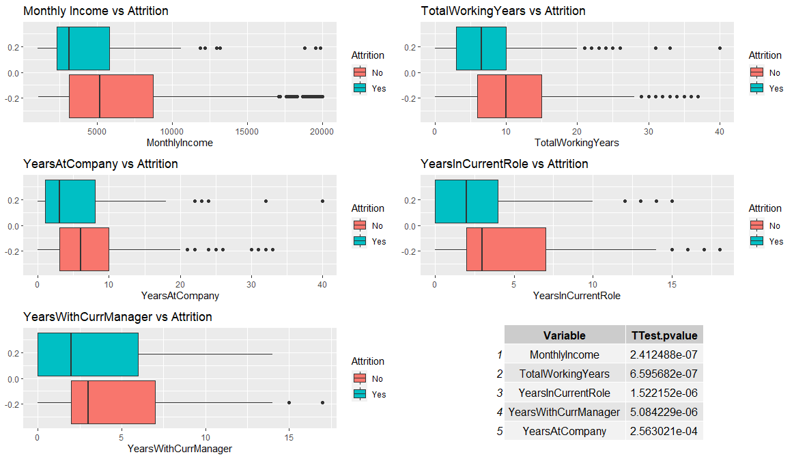
Attrition – Continuous Variables

Slide 6
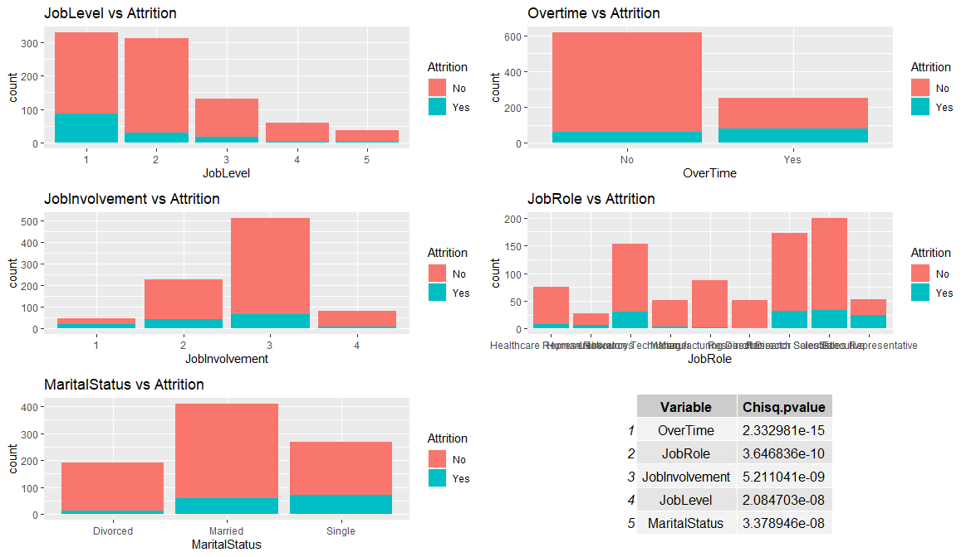
Attrition – Categorical Variables

Slide 7
Attrition – Top 3 Factors

Slide 8
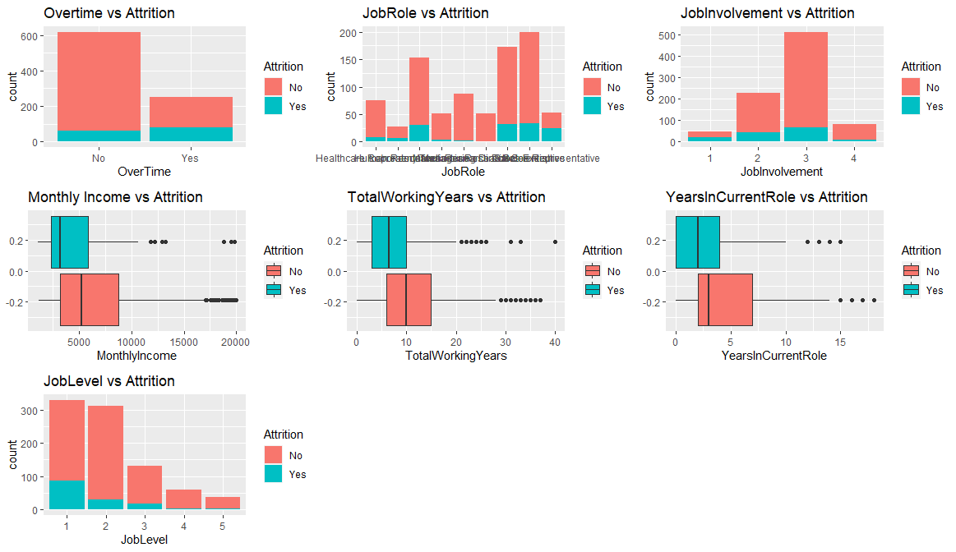
Attrition – Model to Predict
Accuracy: 84%
Sensitivity: 88%
Specificity: 62%

Slide 9
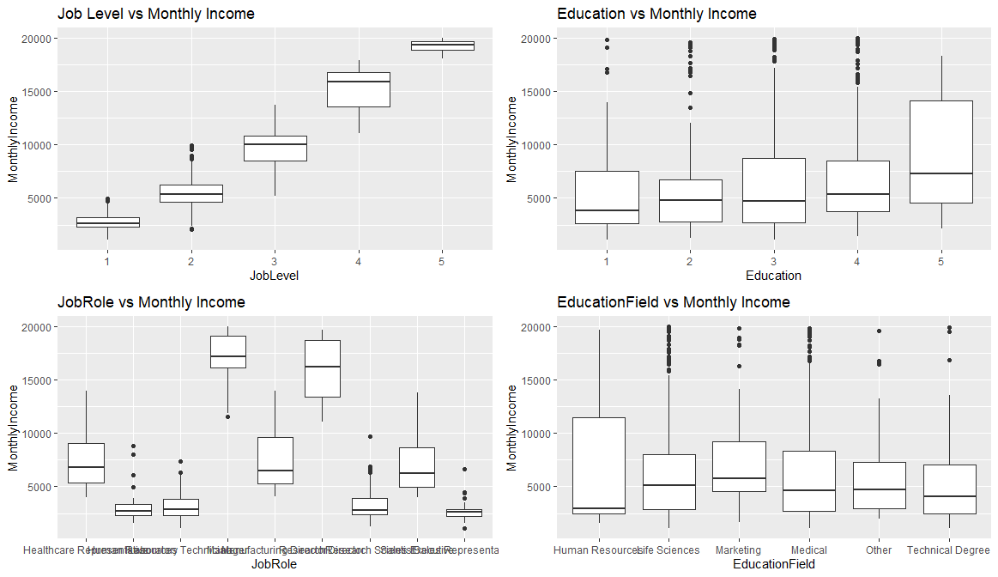
Monthly Income – Categorical Variables

Slide 10
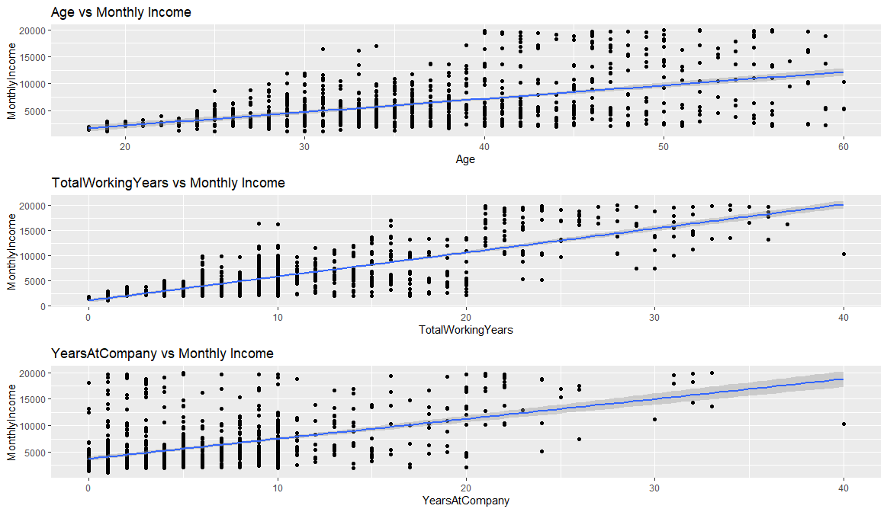
Monthly Income – Continuous Variables

Slide 11
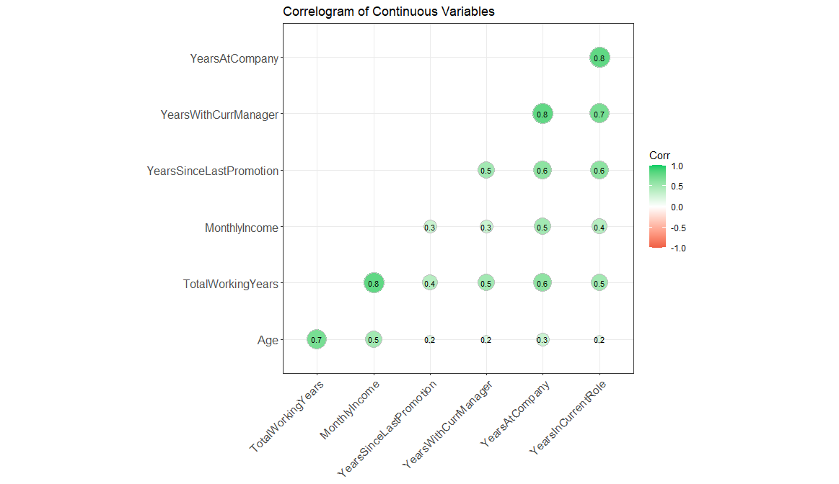
Monthly Income – Continuous Variables

Slide 12
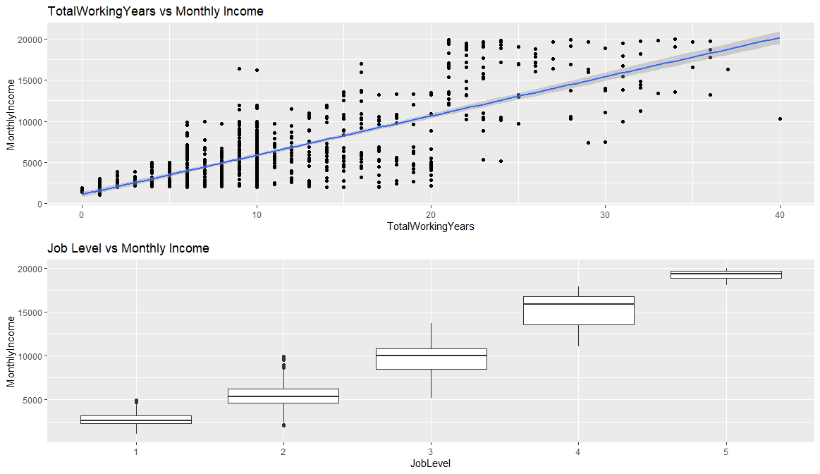
Monthly Income – Model to Predict
R^{2:}
.93
RMSE:
$1262

Slide 13
Summary
Removed 3 variables from consideration (StandardHours, Over18, EmployeeCount)
10 Variables considered for Attrition Prediction Model
5 Categorical
5 Continous
Final Attrition Prediction Model had 7 Variables(4 Categorical/3Continuous)
Sensitivity = 88%
Specificity = 62%
7 Variables considered for Salary Model
4 Categorical Variables
3 Continuous Variables
Final Salary Model has 2 Variables (1 each Categorical/Continuous)
R² = .92
RMSE = $1262

